Slide 1
Arrays
Hy-Tech Club: Web 102
Notes:
This lesson is going to cover arrays – what they are, why we need them, and how to use them!

Slide 2
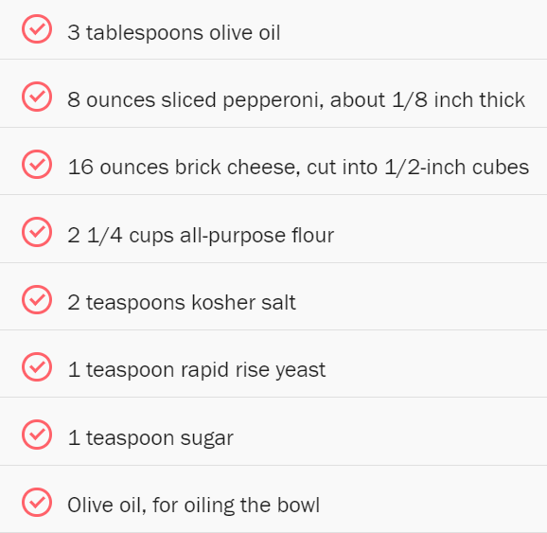
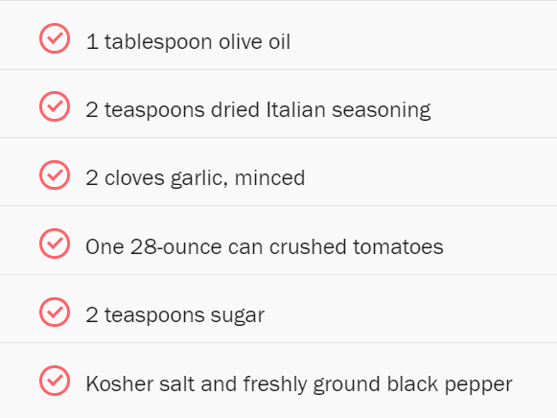
INGREDIENTS
Notes:
What does this look like?
It’s a list (or collection of ingredients! Can anyone guess what these ingredients make? Pizza!

Slide 3
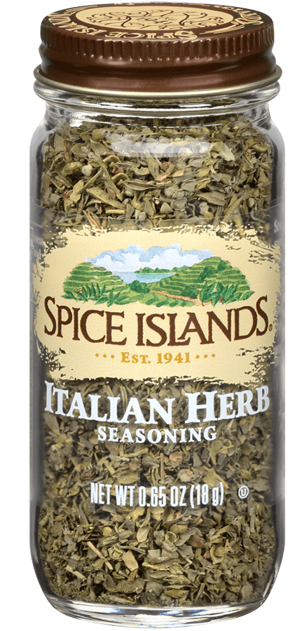
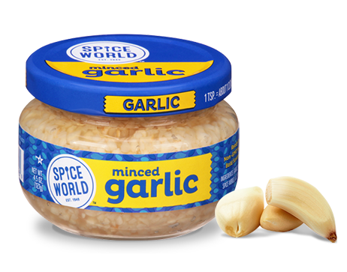
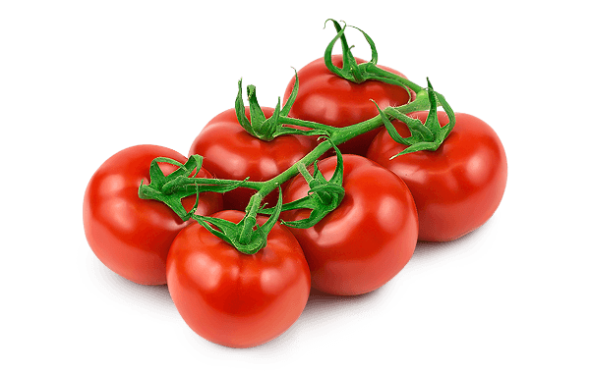
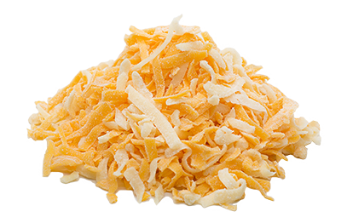
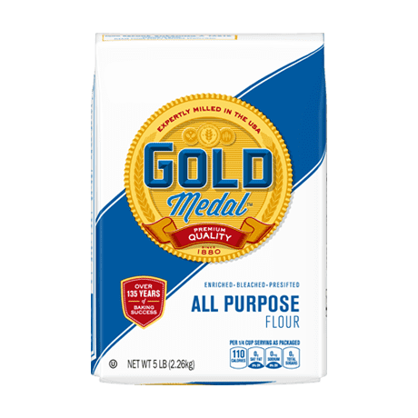

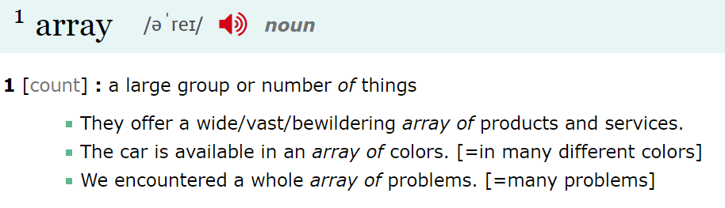
🍕🍕 An Array of Ingredients 🍕🍕
Notes:
So, does anyone know what an array is? Just in English, not in programming.
In English, an array is a group, or collection. Here are some example sentences. What about in programming?

Slide 4
Arrays in Programming
An array is a special kind of variable that points to a list of multiple values
Top 10 Movies
Shop Inventory
To-Do List
List of lists of lists
So what can you store in an array?
Tweets in a Timeline
Team Roster
Music Playlist
Recipe Ingredients
Notes:
In programming, an array is basically a list of values – it’s a special kind of variable that contains a list of other values.
So what do you think we could store in an array? What types of things would you store in a list?
There are a ton of different things these things can store! Top 10 Movies, music playlist, etc etc etc
Even a list of lists of lists – like this Wikipedia page!

Slide 5
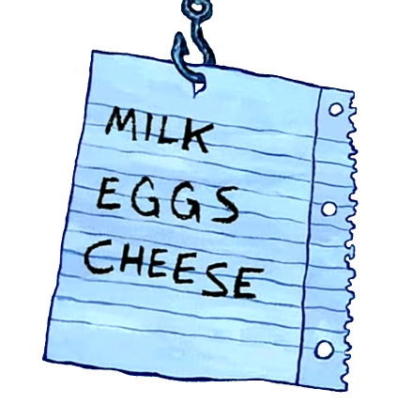

Creating an Array – New Syntax
Square Brackets
[ and ]
Comma
,
let shop = ["MILK", "EGGS", "CHEESE"];
Index | 0 | 1 | 2
Value | "MILK" | "EGGS" | "CHEESE"
Notes:
Now let’s take a look at some syntax (aka the text symbols we’ll need to use to make arrays).
Two important new symbols – we call these square brackets. They should be the same place as the curly brackets on your keyboard, but you don’t have to hold down shift!
Next is the comma. Hopefully you have seen these before! These three symbols are the only new ones. The rest of the array creation is exactly the same as creating any other variable!
We start with let, then a variable name and equals sign. Then, what do we have? Square brackets! Then we have a string value, followed by what? A comma! That goes on until the closing square bracket and semi-colon.
What we have in the shop variable now is an array containing 3 items. Each item has an index. Does anyone know what an index is?

Slide 6
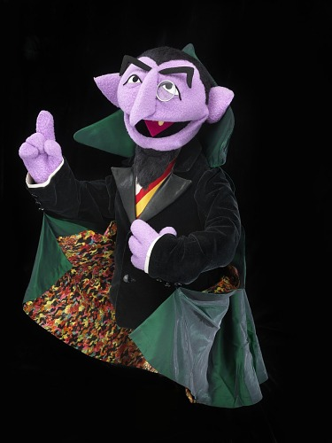
Array Storage by Index
What’s the first number?
In memory, the index of a value is its position in the array
0
Notes:
So now

Slide 7
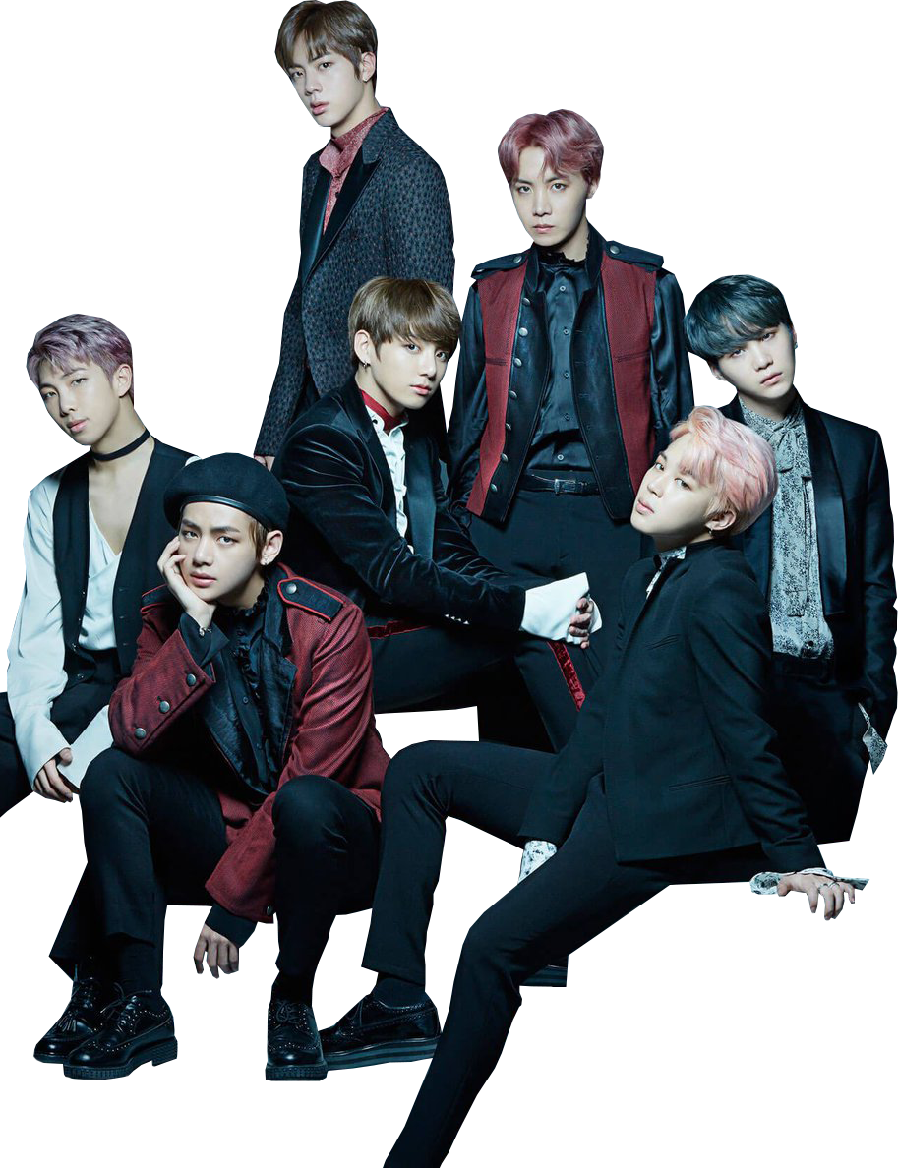
Index Mini-Quiz
["Jung Kook", "V", "Jimin", "SUGA", "Jin", "j-hope", "RM"]
Who is at index 0?
Jung Kook
Notes:
Here we have an array containing the seven members of BTS. We’re going to do a little quiz using this array, and I want a different person to answer for each question.
First question: Who is at index 0?
It’s Jung Kook!

Slide 8
Index Mini-Quiz
["Jung Kook", "V", "Jimin", "SUGA", "Jin", "j-hope", "RM"]
RM is at which index?
6
Notes:
Alright, next question: RM is at which index?
6!

Slide 9
Index Mini-Quiz
["Jung Kook", "V", "Jimin", "SUGA", "Jin", "j-hope", "RM"]
Who is at index 5?
j-hope
Notes:
Next question – who is at index 5?
It’s j-hope!

Slide 10
Index Mini-Quiz
["Jung Kook", "V", "Jimin", "SUGA", "Jin", "j-hope", "RM"]
V is at
which index?
1
Notes:
Last one – V is at which index?
It’s 1 ☺

Slide 11
Index Mini-Quiz – Full Indexing
["Jung Kook", "V", "Jimin",
"SUGA", "Jin", "j-hope", "RM"]
Index | Value
3 | Suga
4 | Jin
5 | j-hope
6 | RM
Index | Value
0 | Jung Kook
1 | V
2 | Jimin
Notes:
Let’s take a look at the whole array with all of the indexing.
Here’s the array again…
And here’s all the indices!

Slide 12
Accessing Values by Index
Get a value from an array at a position
let games = ["Yellow", "Crystal", "Emerald"];
[ and ]
0
1
2
Array name
Square brackets
Index
let game2 = games[1];
Notes:
So now you have an idea of how arrays are stored… but how can you actually interact with them?
One of the first things you’ll want to do is get values based on their position.
Let’s say we have this array. What are the index values?
Yellow is 0,
Crystal is 1,
and Emerald is 2. So let’s say we want to access “Crystal” from this games array.
We will need these symbols again… and what are they called? Square brackets! From these components, we should have everything we need… let’s look at how it’s done.
Let game2 equal games square brackets, and 1 inside the square brackets. After this line of code, the value of the game2 variable will be “Crystal”! Let’s brake it down. We have our variable creation, that’s the same as always. Next, we have…
The variable name for the array! Followed by…
Square brackets! Next comes…
The index between the square brackets! And that’s it.
Now, the value of game2 will be “Crystal”.
So to recap, there are three things needed to access a value from an array: the array name, square brackets, and the index of the value.

Slide 13
Setting Values by Index
Set a value for an array at a position
let games = ["Yellow", "Crystal", "Emerald"];
Name
[ ]
Index
Equals
Value
"Ruby"
0
1
2
[ and ]
games[2] = "Ruby";
Notes:
So we know how to get a value from an array…
Now let’s see how we can set a value!
We’ll use the same example as before.
Same indexes.
We will also need these again… and what are they? Square brackets! So let’s take a look at how we do this.
Here’s the code! It might look a little familiar, with just the left and right flipped.
We start with the name of the array.
Next, we have square brackets again.
After that, we have the index. And which array item will this update? The third one, or “Emerald!”
Then the equals sign and the value, which will get passed to the array and set in the place of the original item.
So to recap, here are all the things needed – start with the name of the array, then the square brackets, then the index, then an equals sign, and finally, a new value.

Slide 14
Adding New Values
Add a new value to the end of an array
let games = ["Yellow", "Crystal", "Ruby"];
let games = ["Yellow", "Crystal", "Ruby", "Sword"];
.push( )
Array Name
Dot: .
Function: push
Parentheses: ( )
Value
games.push("Sword");
Notes:
So we can work with existing elements, but how do we add a totally new element?
We can add a new value to the end of an array using push!
Let’s continue to use this example of games.
We can use the push function to add an element to the end of this array!
It looks like this: games dot push parentheses quotes sword semi-colon!
We once again start with the array name
And then we have dot push and parentheses
And then we have a value within the parentheses – this will get added to the array at the end!
So to review, we start with the array name, then we have a dot, then we have the function name of push, then we have the parentheses, and then we have the value between the parentheses!

Slide 15
Array Example: Sorting
https://replit.com/@HylandOutreach/Arrays#script.js
Notes:
Now let’s actually take a look at the code in action!
Walk through this example in Replit. Ask the students how they might change what is happening.

Slide 16
Array Length
Get the number of elements in an array
let games = ["Yellow", "Crystal", "Ruby", "Sword"];
4
Array name
Dot: .
Property name: length
.length
let count = games.length;
Notes:
Another thing you can do with an array is see how many elements are in it!
You can get the number of elements in an array using length.
Let’s bring back our favorite array for this. How many elements are in this array?
Four! But how do we get that number?
We can use dot length. Note that there are no parentheses – length is a property, not a function!
So let’s see what the code looks like. Here we are creating a new variable named count, and it’s set to the length of the games array! Let’s break it down.
We once again begin with the name of the array.
This is followed by dot length… and that’s it!
Let’s go over everything we need. We start with the array name, then we have a dot, and then we have the property name: length. So what can we do with this length? Anyone have any ideas?

Slide 17
Looping Through Arrays
Loops can access each element of an array
for (let i = 0; i < games.length; i++) {
let currentGame = games[i];
alert(currentGame);
}
for
games.length
games[i]
Notes:
One of the main things we can do with the length of an array is use it to loop through the array!
Using a loop, it is possible to access each individual element of an array, and do something with all of them!
This involves applying concepts that we have already learned – the basic for loop structure, .length, and accessing elements by index.
The for loop structure is almost exactly the same as the one that’s used to loop through a set number of times. For, let i = 0, i < something, i++, body… the main difference:
Instead of a static number, the number in the condition is games.length – this means the loop will execute the same number of times as the number of elements in the array! Once per element. And in the body…
The code can access an individual element using games[i]! Here, the currentGame variable will be set to the value from the array. It can then be alerted!
This loop will keep looping until each element in the array has been accessed!

Slide 18
Array Example: Looping
https://replit.com/@HylandOutreach/ArraysLoop#script.js
Notes:
Now let’s see this code in action!
After running the code, add an element to the initial array definition, and show how it adjusts the number of times the loop executes.

Slide 19
THANK YOU!
WHAT QUESTIONS DO YOU HAVE?
Notes:
Does anyone have any questions? Thanks!

